Slide 1
Interestingness of a picture
Derek liu

Slide 2
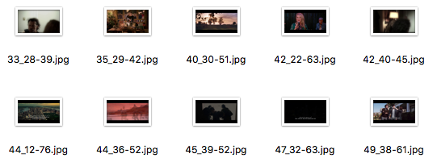

data
Interestingness Dataset from Technicolor - a collection of movie excerpts and key-frames and their corresponding ground-truth files based on the classification into interesting and non-interesting samples.
Objective
Use deep learning to classify images based on the interestingness

Slide 3
AGENDA
1. EDA
2. Baseline model
3. Simple CNN
4. More complex
5. Analysis
6. Conclusion

Slide 4
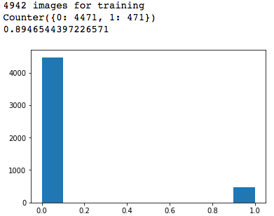

What is so challenging about binary image classification?

Slide 5
Initial thoughts
Make the model avoid to predict the majority class to achieve high accuracy
Assigning weights to both class where the major class will get a lower weight
Oversampling, undersampling, or combing both

Slide 6
Simple baseline

Slide 7
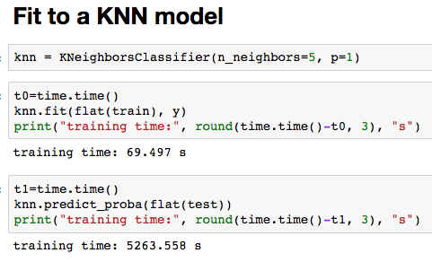
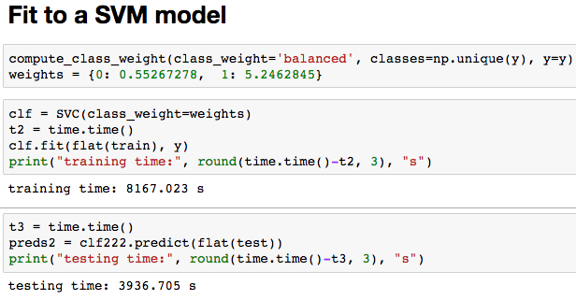
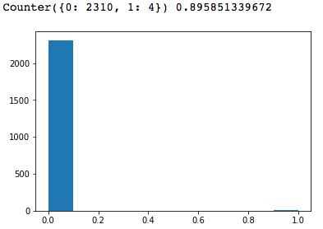
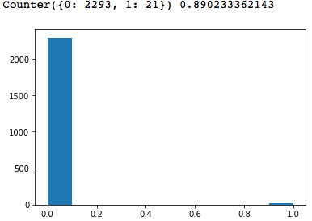


Slide 8
TAKEAWAY
Both model are predicting mostly class 0 to achieve high accuracy
The data that fits into the model were all flattened, this could be a major cause

Slide 9

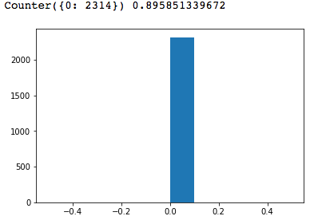
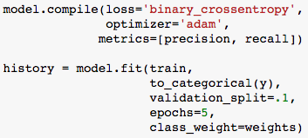


Slide 10
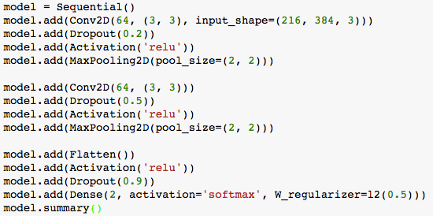


Slide 11
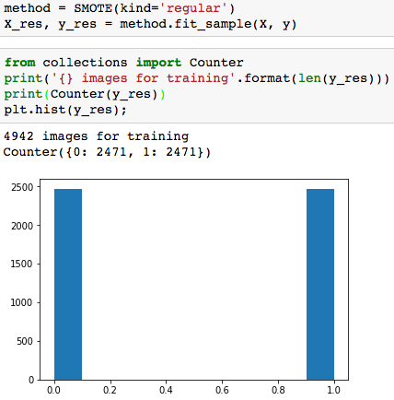
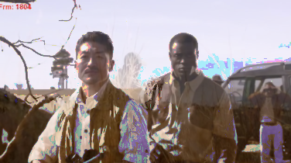
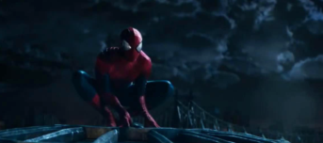

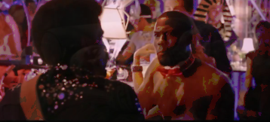
BALANCING DATA
Combination of oversampling and undersampling
Imblearn SMOTE

Slide 12
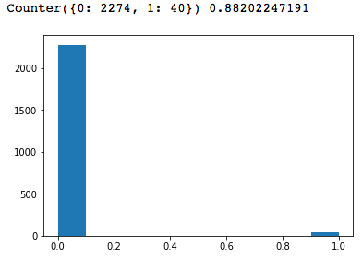
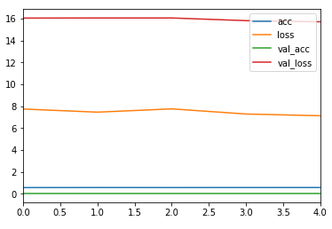


Slide 13

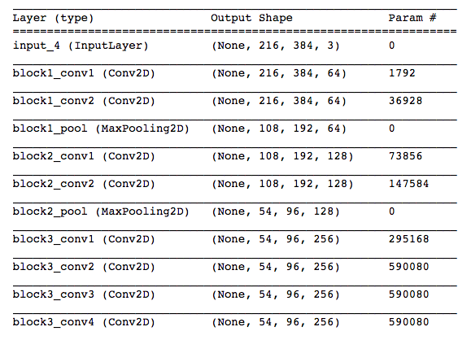

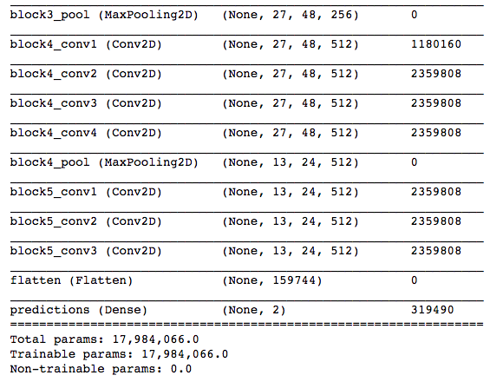


Slide 14
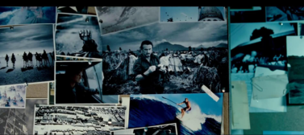
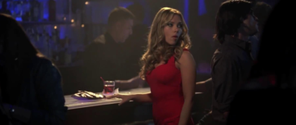
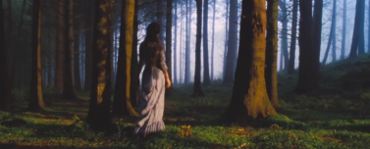
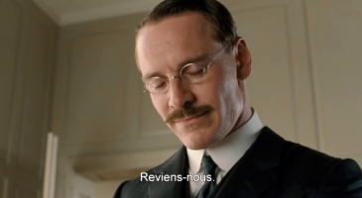
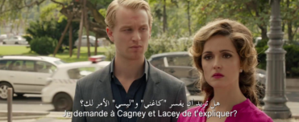
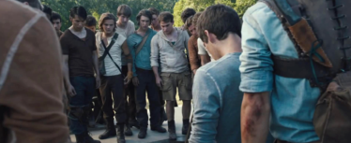

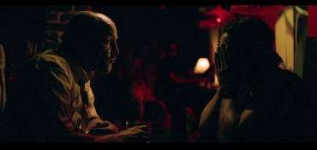

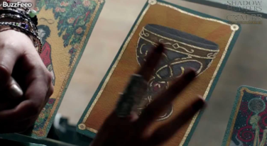
Conclusion
Way too imbalanced.
The data is bad.
Need more samples.

